Slide 1
ATM Banking Project
Using .Net Framework, Reactjs and mssql server

Slide 2
Group 2
Batch 2
Team – Aryan Srivastava, Ishaan Agarwal, Pallavi Buwa, Rwitick Ghosh

Slide 3
Aryan Srivastava
Database storage – Schema
Backend – Repository
Frontend – Multiple pages including Login, Sign-Up, functionalities such as context, protected route, UI/UX design, storage persistence
Ishaan Agarwal
Database storage – Schema
Backend – Context, Utilities
Frontend – Multiple pages including Transactions, Details of account, Create Account, UI/UX design, functionalities such as admin route
Team
Pallavi Buwa
Database storage – Schema
Backend – JWT generation, User Repository, Authorization Service, User Controller, Unit Testing
Frontend – UI/UX design, Navigation bar, Theming and colors
Rwitick Ghosh
Database storage – Schema
Backend – Account Service, Account Controller, Utilities such as password hashing, Authorization middleware, Interface declarations, Unit Testing
Frontend – UI/UX design, Theming and colors

Slide 4
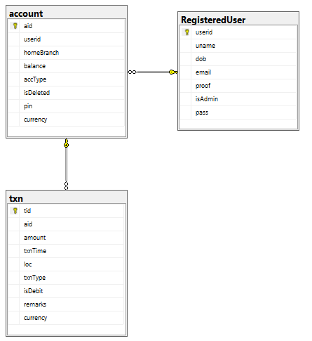
Database Schema

Slide 5
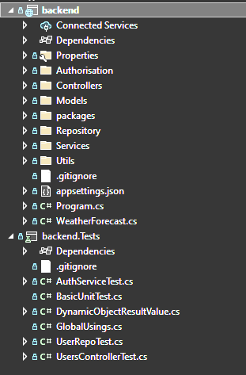
Backend folder structure
As viewed by Visual Studio solution explorer

Slide 6
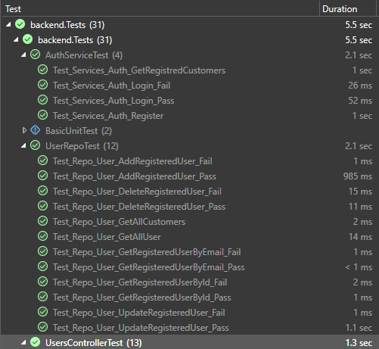
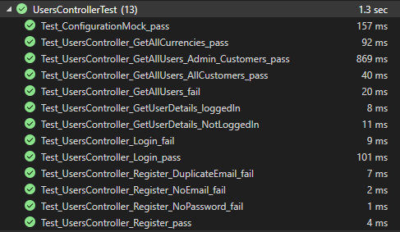
Backend unit test results
As viewed in Visual Studio Test Explorer

Slide 7
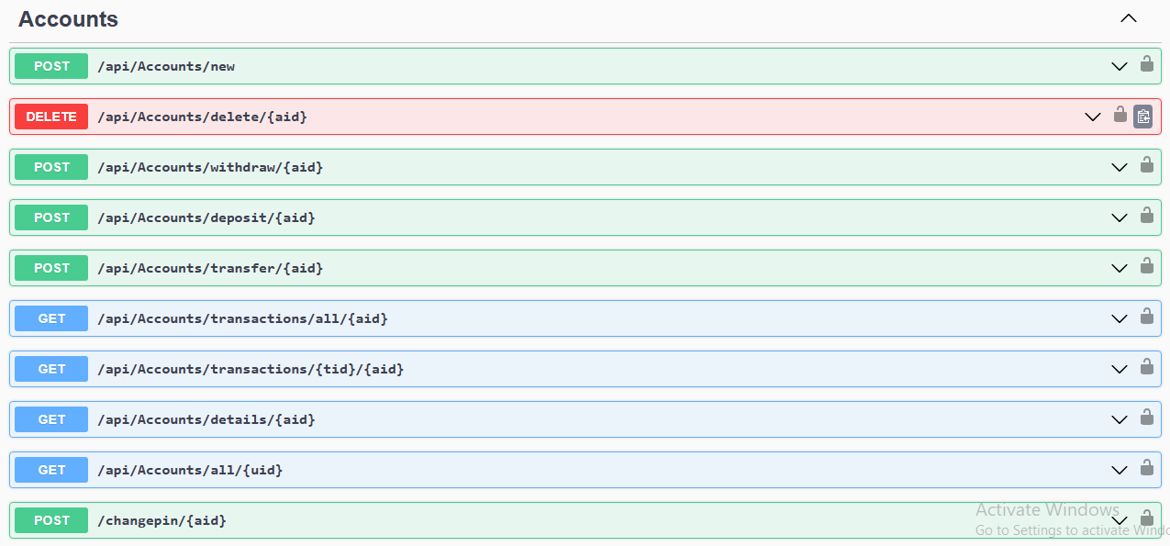
Swagger View
View of the endpoints in Swagger provided by .Net framework

Slide 8
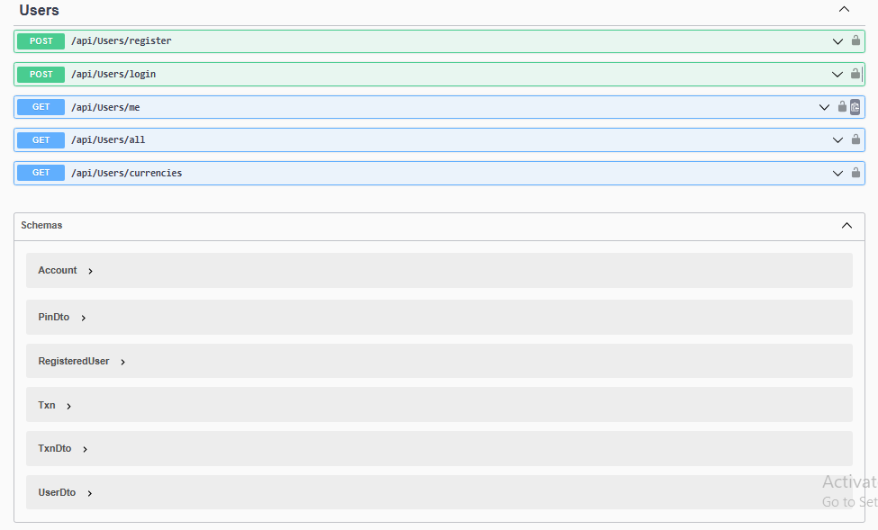
Swagger View (continued…)
View of the endpoints in Swagger provided by .Net framework

Slide 9
Screens
Demo client application screengrabs for functionality view

Slide 10
sample

Slide 11
Thank You
Group 2, Batch 2 of .Net framework, Hyderabad

